Slide 1
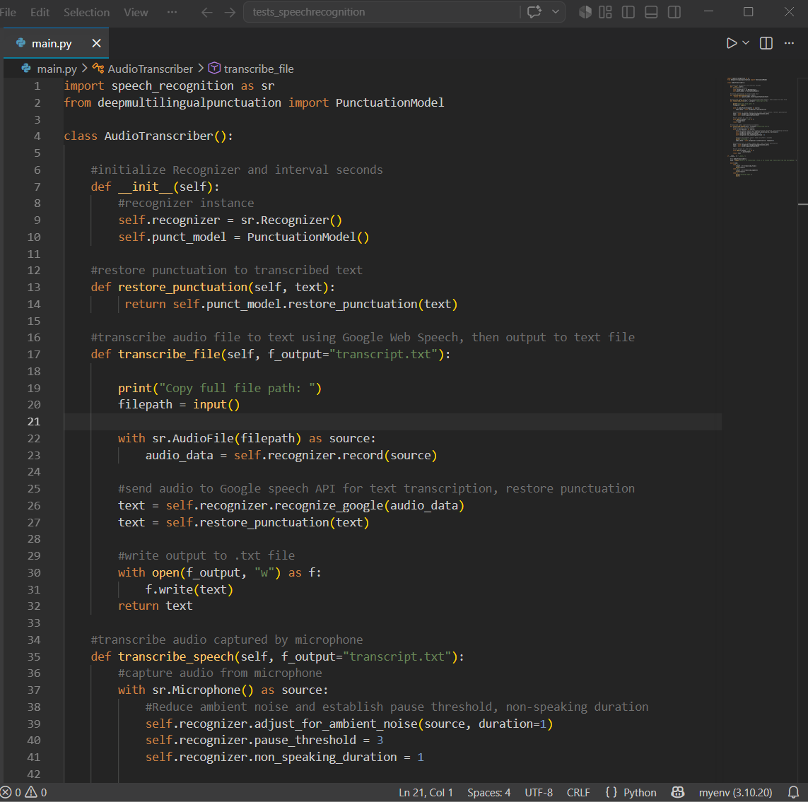
CS3080 Final Simple Speech-to-Text
Function: Take either pre-recorded or live audio input and output a plain text file
AudioTranscriber
Implements all transcription functionality
Packages
SpeechRecognition: recognize() function uses Google Web Speech API to transcribe
DeepMultilingualPunctuation: restores punctuation using transformer model to predict punctuation after each word

Slide 2
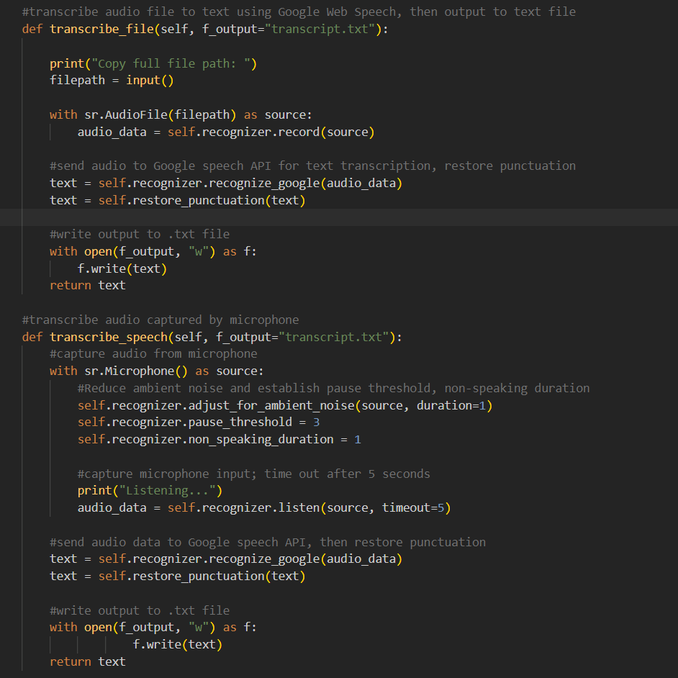
Main
User chooses between file or microphone transcription
File transcription:
Prompts user for a file path
Loads audio using AudioFile
Sends audio Google Web Speech API
Restores punctuation before writing to transcript.txt
Microphone Transcription
Live audio captured using Microphone()
Ambient noise, pause and non-speaking thresholds to capture better input
Audio recorded with a timeout
Sent to Google Web STT, then output punctuation restored before writing to transcript.txt

